Slide 1
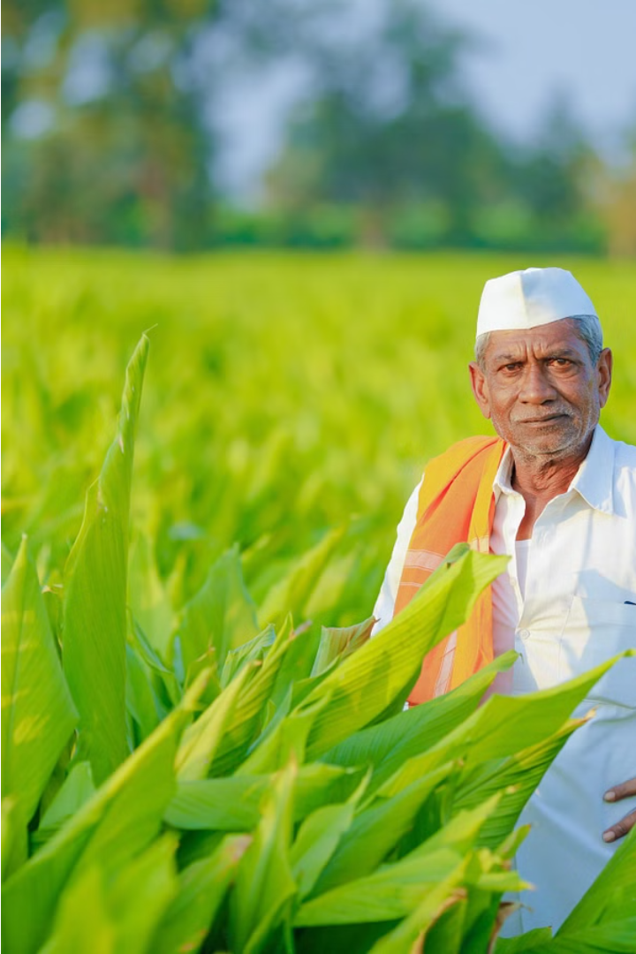

Agrofounder
Revolutionizing Agriculture in India
We are an idea stage agriculture startup working towards the wellbeing of Indian farmers by collaborating with farmers and farmer producer companies.
by Mahesh Hon

Slide 2
Challenges Faced by Indian Farmers
Average Farm Size
Poor Infrastructure
Low use of Farm Technologies
Many Indian farmers own small and fragmented land which limits their productivity.
The lack of proper irrigation, storage facilities, and transportation causes a huge loss to the farmers' profits.
Most farmers still rely on traditional methods of farming which leads to low efficiency and output.

Slide 3
Unpacking Farmers' Production and Selling Issues
High Post-Harvest Losses
1
Many farmers in India face huge post-harvest losses due to improper handling, packing, storage, and transportation.
2
Low Market Access and Information
Access to markets, pricing, and demand information has long been a challenge for Indian farmers.
Dependence on Middlemen
3
Most small farmers in India are dependent on intermediaries who often pay them unfairly and exploit them financially.
4
Group Bargaining Power
Farmers working together in groups can negotiate better prices than individual farmers can alone.

Slide 4
New Initiatives by the Government of India
Introduction of Farmers Producers Companies
1
Farmer Producers Companies (FPCs) are farmer-owned and farmer-managed companies which help farmers to manage and market their produce efficiently.
2
Benefits of FPCs
FPCs help farmers with better pricing, technical knowledge, storage, and transportation facilities thus increasing their income and livelihood.
Growth of FPCs
3
Over the past few years, more and more farmers have been joining FPCs. The number of FPCs in India is growing rapidly and connecting more farmers every day.

Slide 5
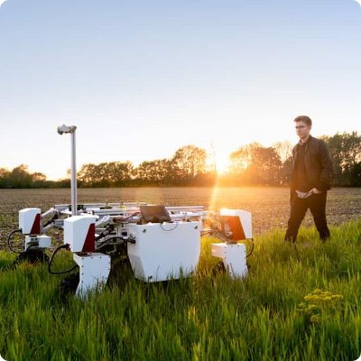
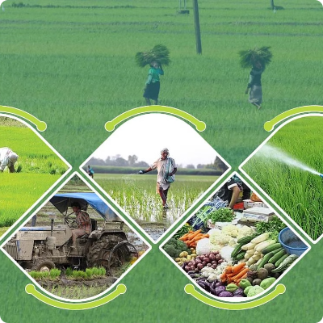
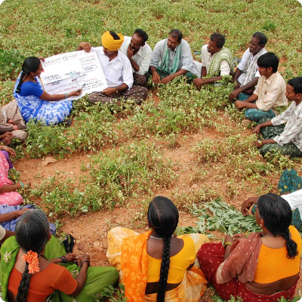
All About Farmer Producers Companies
Benefits of FPCs
Year-on-Year Growth of FPCs
Success stories of FPCs
FPCs help farmers to obtain better prices, reduce risks, gain access to information and technology, and secure inputs, credit, and services at better terms.
Sahyadri Farms​ (FPC) set up by Vilas Shinde in 2011, has grown to become the largest FPC in the country, with a membership of 8,000 farmers and a turnover of Rs 300 crore.
As of 2021, there are over 9000 FPCs in India with a combined turnover of over INR 41 billion, and this number is only increasing with each passing year.

Slide 6

Who We Are ?
Agrofounder is an agritech startup that empowers farmers by pushing them to start Farmer Producer Companies (FPCs). Also helping FPCs to connect with farmers and other agriculture sector related companies . Our platform provides a space for FPCs and farmers to collaborate and thrive.

Slide 7
Our Work
FPCs to Farmers (Farmers Connect)
FPCs to Various Agri Sector Companies
We are also connecting FPCs With Agriculture companies, such as agriculture export companies, seed providers, and agriculture material providers through our platform. Here's how they can collaborate:
1
Direct Communication:
FPCs and Farmers can communicate directly with each other through our platform.
1
Direct Communication:
2
FPCs and agri sector companies can communicate directly with each other through our platform
Marketplace:
Our platform includes a marketplace where FPCs and Farmers can buy and sell products.
2
Marketplace:
3
Our platform includes a marketplace where FPCs and agri sector companies can buy and sell products
Resource Sharing:
FPCs and Farmers can share knowledge on our platform This allows for more efficient and cost-effective farming practices.

Slide 8

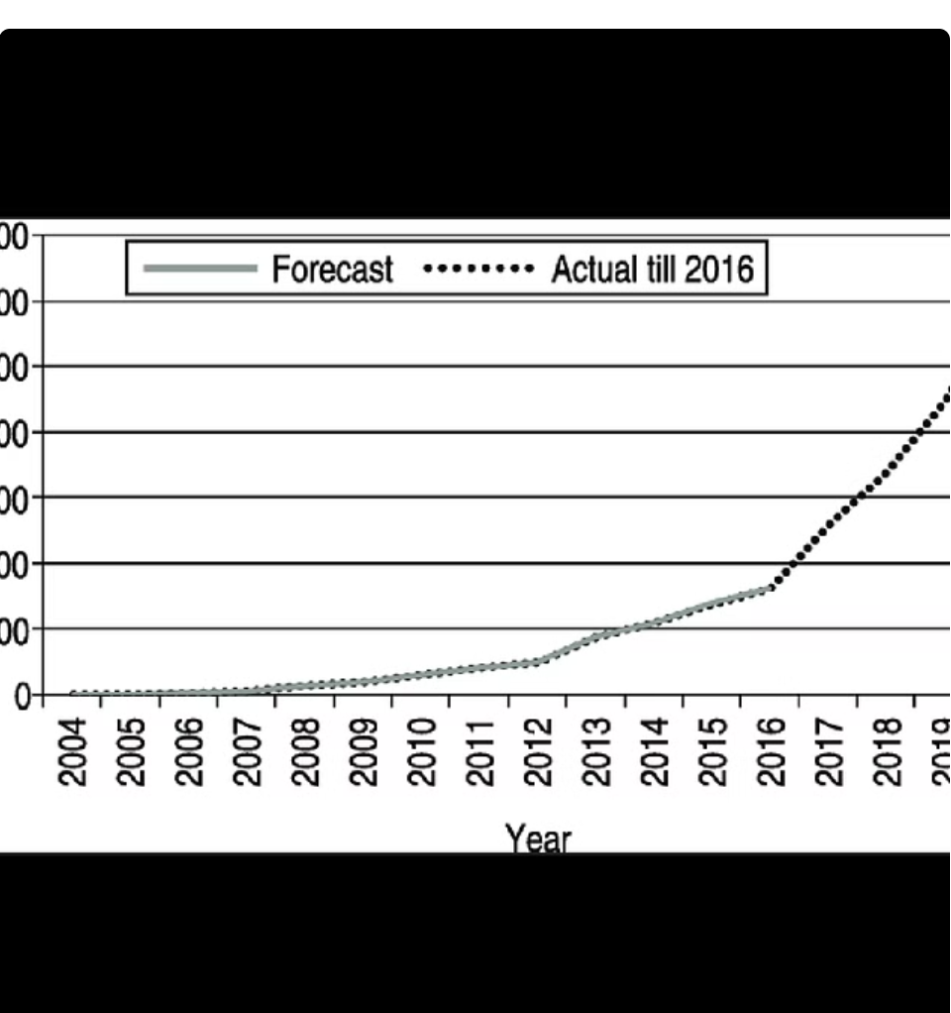
Target Market
The Above data specifies that our Market have shown a phenomenal growth in last decade.

Slide 9
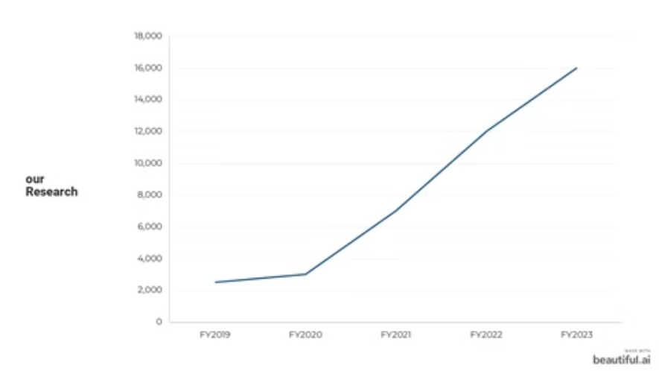
there are a total of 16,000 FPCs in the country, as of February 2023, according the Union Ministry of Corporate Affairs.
In the last three years: 2020-21, 2021-22, 2022-23, when 65 percent of the FPCs were registered.

Slide 10
Market Acquisition Strategy
Targeting FPCs
Competitive Benefits
1
Efficient Targeting:
1
First and Fast Mover:
Targeting FPCs is more efficient and effective than targeting individual farmers. One FPC can bring in a large number of farmers, and it's easier to convince an FPC to use our platform than to approach farmers individually.
We are the first and fastest mover in the market, giving us an advantage over competitors.
2
Direct Connection with Farmers:
We have a direct connection with farmers through FPCs, allowing us to better understand their needs and provide them with the best possible service.
2
Large Reach:
Targeting FPCs allows us to reach a large number of farmers at once.
3
Elimination of Traders:
3
Early Market Penetration:
By eliminating traders, we are able to provide farmers and FPCs with maximum benefits and reduce unnecessary costs.
Targeting FPCs allows us to penetrate the market early and establish ourselves as a preferred platform for farmers and FPCs.

Slide 11
Revenue Model
Commission Model
Subscription Model
Advertisement Model
Charges from FPCs for our service. We also have a premium subscription model which will avail premium services for FPCs.
1
Middleman Commission:
1
Advertising:
We can advertise both farmers and FPCs on our platform to generate revenue. This can include targeted ads, sponsored content, and featured listings.
We can collect a commission when we work as a middleman between FPCs and other agricultural companies for selling their production. This will be a major source of revenue for our platform.
Extra Services:
We can offer FPCs additional services for better interaction with farmers, such as dedicated account managers, marketing support, and customized reports. FPCs will pay a fee for these services, which will contribute to our revenue.

